Slide 1

LEAD SCORING CASE STUDY
Shubhi Mishra
Bharath raja
M S Vivek Anand

Slide 2
Business Objective:
To Help X Education Select Most Promising Leads (Hot Leads), i.e. The Leads That Are Most Likely To Convert Into Paying Customers.
❖ Selection of hot leads
❖ Focused marketing
❖ Higher lead conversion rate

Slide 3
GOALS :
❖ Create a Logistic Regression model to predict the Lead Conversion probabilities for each lead.
❖ Decide on a Probability Threshold value above which a lead will be predicted as converted, whereas not converted if it is below it.
❖ Multiply the Lead Conversion probability to arrive at the Lead Score value for each lead.

Slide 4
APPROACH:
❖ Reading & understanding the data
❖ Data cleaning
❖ EDA
❖ Feature scaling
❖ Prepare the data for modelling
❖ Model building
❖ Model evaluation
❖ Making predictions on the test
❖ Assigning lead score
❖ Hot leads Determination

Slide 5
Data Cleaning:
There were few columns which were having a high number of null values which are dropped straight away. Further, we can not eliminate all columns which might be useful and were having a great impact on our model but are having a strong possibility of high number of null values so we can treat those columns by imputing with mean and median by observing the type of the variables i.e. (continuous or categorical). The outliers which were found during the analysis has also been removed. After those process up to 98% data has been retained and on this cleaned data the analysis was performed.

Slide 6
EDA:
EDA was performed on the cleaned data by plotting different types of plots and analysing both the variables which is continuous and categorical. Univariate analysis was done against the target variable for better understanding. It looks at the range of values, as well as the central tendency of the values. It describes the pattern of response to the variable and it also describes each variable on its own.
Some of the insights are as follows: People spending more time are promising Leads, The Lead Origin- Landing Page Submission has the highest conversion rate among others, Google has the highest conversion rate, leads whose Last Activity was SMS sent had the best conversion rate, Lead from Specialization who are unknown/Select columns has the highest rate of conversion, Person who are working professional has the highest conversion rate comparatively to others.

Slide 7
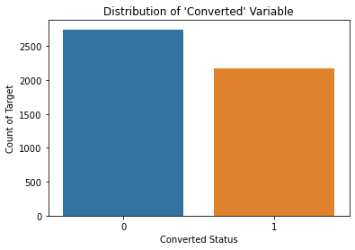
Numerical Variable Analysis:

Slide 8
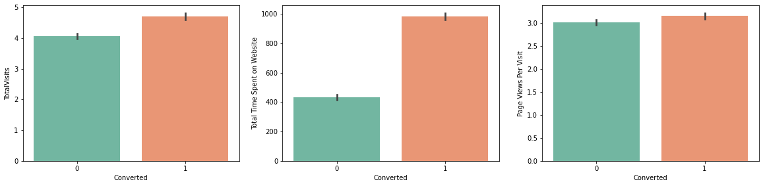
Conversions for all numeric values:

Slide 9
Model Building:
❖ Dummy variables were created for categorical columns and scaling was done. In simpler words, we can say that the scaling is used for making data points generalized so that the distance between them will be lower. Scaling was carried out in order to bring all the features into a comparable range. Then we achieved the splitting of train and test dataset with 70% and 30%.
❖ Feature selection was applied using RFE technique and then the elimination was done according the steps followed for fetching the column having high Pvalue & VIF, a final model was obtained after occurrence of 4 times until both VIF and p-values reached under acceptable range.

Slide 10
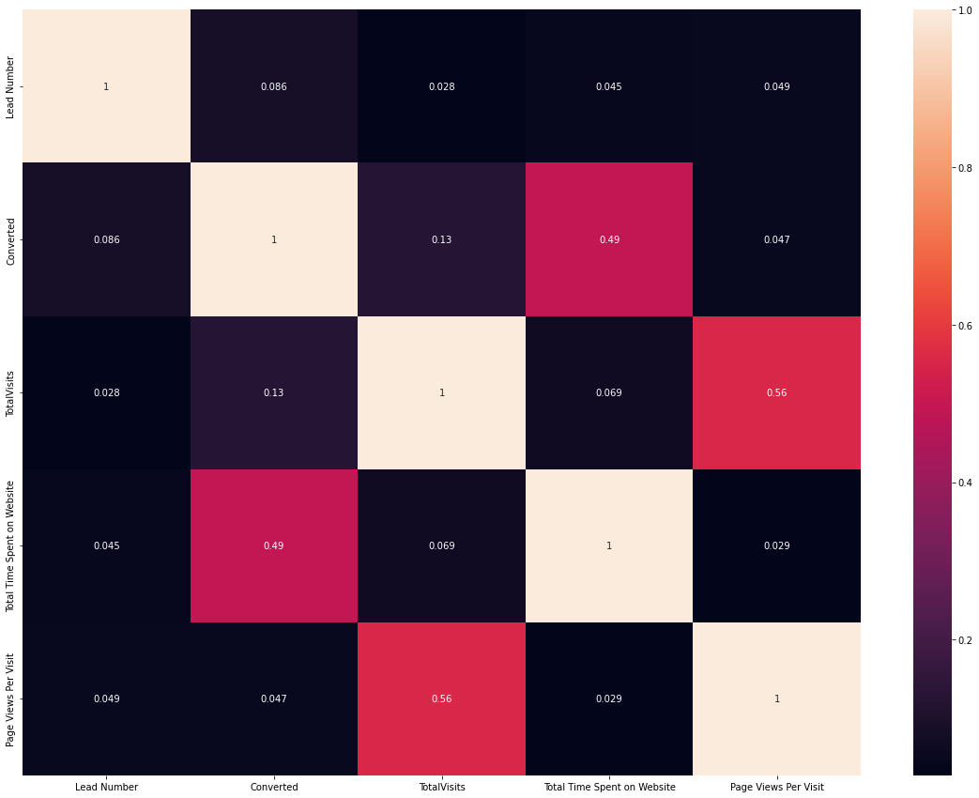
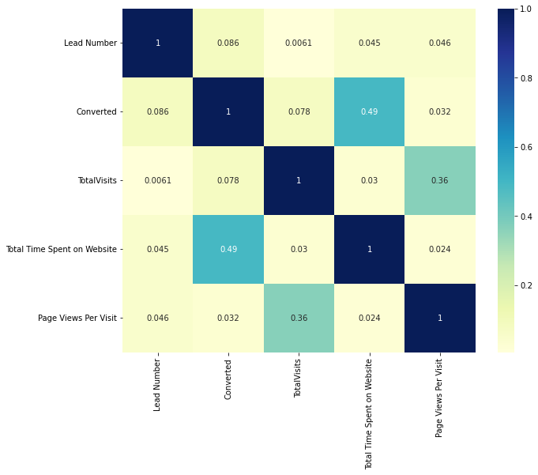
Lead Heatmap:

Slide 11
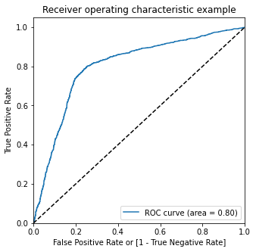
ROC Curve:
The ideal value for the ROC Curve is 1 which indicates a "GOOD Predictive Model," which is what we are obtaining.

Slide 12
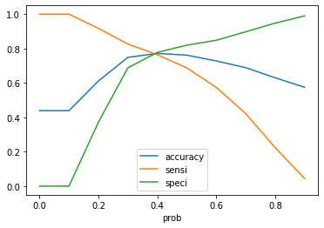
Accuracy sensitivity and specificity for various probabilities:

Slide 13
Inference:
So as we can see above the model seems to be performing well. The ROC curve has a value of 0.86, which is very good. We have the following values for the Train Data:
- Accuracy : 77.05%
- Sensitivity :82.89%
- Specificity : 73.49%
- Some of the other Stats are derived below, indicating the False Positive Rate, Positive Predictive Value, Negative Predictive Values, Precision & Recall.

Slide 14
Conclusion:
While we have checked both Sensitivity-Specificity as well as Precision and Recall Metrics, we have considered the optimal cut off based on Sensitivity and Specificity for calculating the final prediction.
Accuracy, Sensitivity and Specificity values of test set are around 77%, 83% and 74% which are approximately closer to the respective values calculated using trained set.
Also the lead score calculated in the trained set of data shows the conversion rate on the final predicted model is around 80%
Hence overall this model seems to be good.
Important features responsible for good conversion rate or the ones' which contributes more towards the probability of a lead getting converted are :
Lead Origin Lead Add Form
What is your current occupation Working Professional
Total Time Spent on Website

Slide 15
Thank You The END!

